Slide 1
Binary Trees,
Binary Search Trees
COMP171
Fall 2005

Slide 2
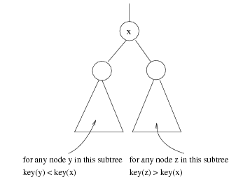
Binary Search Trees
Stores keys in the nodes in a way so that searching, insertion and deletion can be done efficiently.
Binary search tree property
  For every node X, all the keys in its left subtree are smaller than the key value in X, and all the keys in its right subtree are larger than the key value in X

Slide 3

Binary Search Trees
A binary search tree
Not a binary search tree

Slide 4

Binary search trees
Two binary search trees representing
the same set:
Average depth of a node is O(log N); maximum depth of a node is O(N)

Slide 5
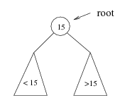
Searching BST
If we are searching for 15, then we are done.
If we are searching for a key < 15, then we should search in the left subtree.
If we are searching for a key > 15, then we should search in the right subtree.

Slide 6
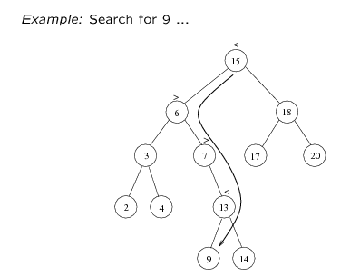
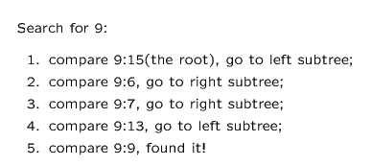

Slide 7
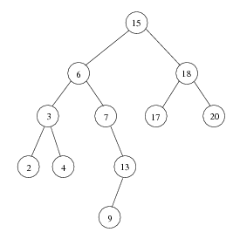
Inorder traversal of BST
Print out all the keys in sorted order
Inorder: 2, 3, 4, 6, 7, 9, 13, 15, 17, 18, 20

Slide 8
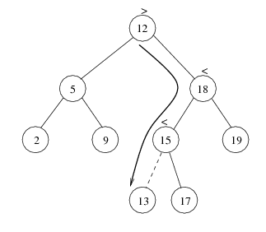
insert
Proceed down the tree as you would with a find
If X is found, do nothing (or update something)
Otherwise, insert X at the last spot on the path traversed
Time complexity = O(height of the tree)

Slide 9
delete
When we delete a node, we need to consider how we take care of the children of the deleted node.
  This has to be done such that the property of the search tree is maintained.

Slide 10
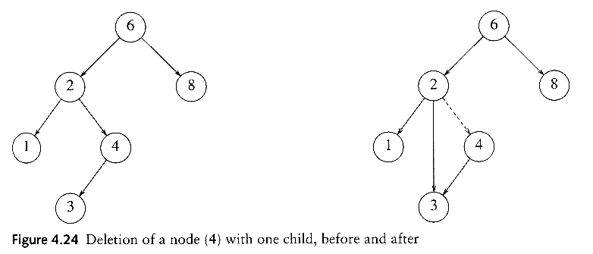
delete
Three cases:
(1) the node is a leaf
  Delete it immediately
(2) the node has one child
  Adjust a pointer from the parent to bypass that node

Slide 11
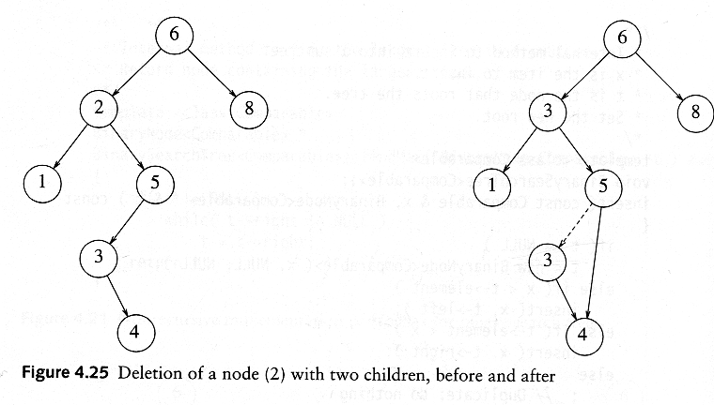
delete
(3) the node has 2 children
  replace the key of that node with the minimum element at the right subtree
  delete the minimum element
    Has either no child or only right child because if it has a left child, that left child would be smaller and would have been chosen. So invoke case 1 or 2.
Time complexity = O(height of the tree)

Slide 12
Removal in BST: Example
Case 1: removing a node with 2 EMPTY SUBTREES
parent
7
cursor
5
9
4
6
8
10
7
Removing 4
replace the link in the parent with null
5
9
6
8
1

Slide 13
Removal in BST: Example
Case 2: removing a node with 2 SUBTREES
- replace the node's value with the max value in the left subtree
- delete the max node in the left subtree
What other element
can be used as
replacement?
Removing 7
cursor
cursor
7
6
5
9
5
9
4
6
8
10
4
8
10

Slide 14
Removal in BST: Example
Case 3: removing a node with 1 EMPTY SUBTREE
the node has no left child:
link the parent of the node to the right (non-empty) subtree
parent
parent
7
7
cursor
5
9
cursor
5
9
6
8
10
6
8
10

Slide 15
Removal in BST: Example
Case 4: removing a node with 1 EMPTY SUBTREE
the node has no right child:
link the parent of the node to the left (non-empty) subtree
Removing 5
parent
parent
7
cursor
7
cursor
5
9
5
9
4
8
10
4
8
10

Slide 16
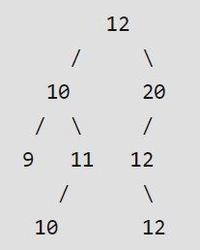
How to handle duplicates in Binary Search Tree?
A Simple Solution is to allow same keys on right side (we could also choose left side). For example consider insertion of keys 12, 10, 20, 9, 11, 10, 12, 12 in an empty Binary Search Tree

Slide 17
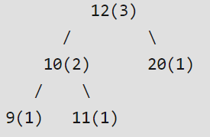
How to handle duplicates in Binary Search Tree?
A Better Solution is to augment every tree node to store count together with regular fields like key, left and right pointers.
Insertion of keys 12, 10, 20, 9, 11, 10, 12, 12 in an empty Binary Search Tree would create following.

